Slide 1
randstad career workshop
kayla newcome | november 16, 2017

Slide 2
overview.
a look into the marketplace
how to write a resume
job search tips
networking tips
q&a

Slide 3
about us.
career workshop

Slide 4
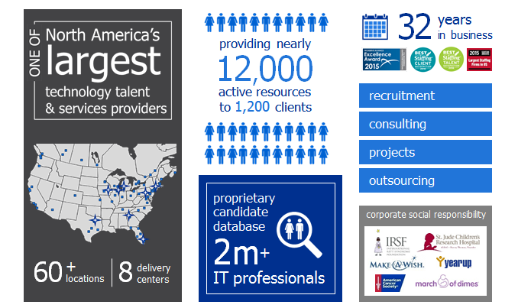
about us.

Slide 5
a look into the marketplace:
career workshop

Slide 6
In October 2017, the US added 261,000 jobs and unemployment is at the lowest level since Clinton was president.
economic news.

Slide 7
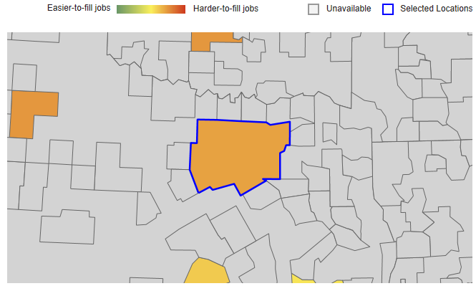
junior business analyst | Dallas metro market
2,000
$73,700 $87,650 $101,650
Passive & active candidates
U$D
40+
job openings
Source: TalentNeuron

Slide 8
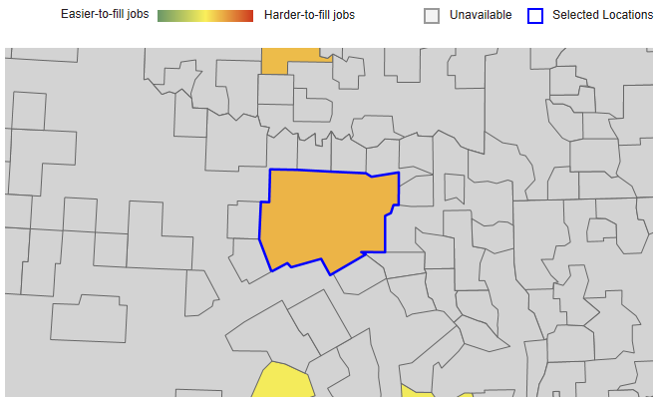
mid-level business analyst | Dallas metro market
1,800
$94,000 $104,050 $114,150
Passive & active candidates
U$D
80+
job openings
Source: TalentNeuron

Slide 9
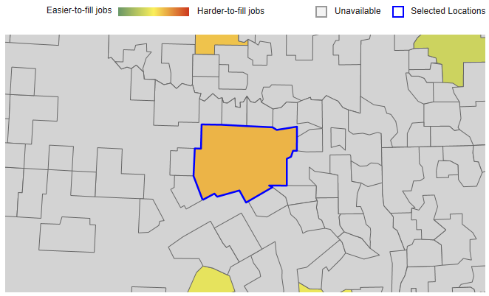
senior business analyst | Dallas metro market
800
$108,550 $118,300 $128,050
Passive & active candidates
U$D
66
job openings
Source: TalentNeuron

Slide 10
how to write a resume.
career workshop.

Slide 11
let’s get started:
do:
customize your resume for every job application.
make your resume easy to scan so we can quickly determine skills fit. recruiters and hiring managers receive dozens or even hundreds of resumes everyday so make sure your resume makes the cut.
make your resume chronological.
list personal information-including your name, address, phone number and email address.
highlight your accomplishments, detail your complete work experience and education, make mention of additional skills and interests and end with your reference statement.
Notes:
Do: One of our best resume tips is customizing your resume for every job application. Before applying, try to understand a company's values and core competencies. Analyze the key responsibilities of the job description and include key words and phrases in your work experience and cover letter to show that you are the perfect fit for the position.

Slide 12
work experience.
do:
include accomplishments a potential hiring manager will find most attractive on your resume.
use data points that prove your value, such as “delivered project 2 weeks under schedule and under budjet by 5%..." etc.
include information that explains any employment gaps
Notes:
When you have been out of work for two years or more, it's important to include information that explains the employment gap. If you spent any time during the period performing volunteer work, be sure to include it. Otherwise, you may decide to include titles such as "full time student", "family management" or "personal travel". It is not advisable to mention injuries, rehabilitation or other details that could allow an unscrupulous hiring manager to discriminate against you.

Slide 14
education.
do:
include degrees and certifications and be sure to mention dates, majors, minors and honors
list your GPA if it is 3.0 or higher
list your education below your work experience if you have worked for more than 5 years.
include any pertinent certifications

Slide 15
…and don’t forget.
file formats
Choose the appropriate file format for presenting your electronic resume. For heavily formatted resumes, be sure to save the file in PDF format to ensure the resume is presented as you intended. If working with a recruiter, save in Word format. Have a trusted friend or family member proof-read and suggest edits. If your resume contains industry specific terms, have a peer take a look.

Slide 16
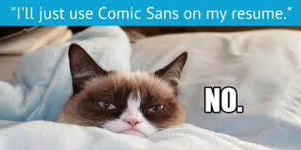

Slide 17
job search tips.
career workshop.

Slide 18
job search tips.
do:
be reachable
hit the job boards
apply as soon as a job is posted- sign up to receive auto notifications at www.randstadusa.com
keep your resume up to date- even if you aren’t actively looking for a new job, you’ll want to be ready if your dream job comes along
get trained- technology is always changing so stay up to date through self-study, training classes and bootcamps
utilize linkedin- include a professional picture of yourself, add an about me section, upload your resume (if your search is public), ask for recommendations
Notes:
Be reachable: First things first: Be reachable. Clear your voicemail inbox and record a professional greeting in case you miss a call. Upgrade from that old "crazyman57@hotmail.com" account, and try for a more business-friendly address with your name in it. Check and double check your phone number(s) and email on your resume, cover letters, and LinkedIn accounts. It may sound simple, but it is too important not to mention, be sure that you're reachable.
Job boards will likely be the first place that you visit in your job search. Sites like careerbuilder.com, monster.com and linkedin.com are great starts, but if you want to search for ALL of the jobs, use a job search engine. ZipRecruiter.com and Indeed.com are two of the most popular. They find jobs on popular job boards, niche job boards and even company career pages around the web, and make them searchable in one place.

Slide 19
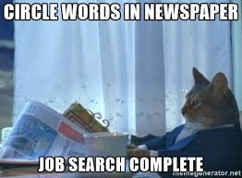

Slide 20
networking tips.
career workshop.

Slide 21
networking tips.
do:
join industry groups or networking events
target by individual- look for folks who are within higher positions than you and connect with them in a genuine way.
bring business cards
follow up with a thank you email
Notes:
These are great places to meet and mingle with people in your industry and impress others with your industry knowledge or personality. You're also likely to receive great job search tips and networking tips from people in your location and industry.

Slide 23
any questions?
career workshop.

